Slide 1
Digital Fabrication Studio CSCE689 Week 1: Lecture Introduction & Course Intro
Jeeeun Kim
Jeeeun.kim@tamu.edu

Slide 2
Today’s agenda
Course Intro: What is and Why Digital Fabrication?
Why digital fabrication in Computer Science?
What you’ll do and learn in this course
Class Structure
Deliverables & Grading
Project overview

Slide 3

Caution
We will watch a LOT of short cool videos
… that will inspire you

Slide 4
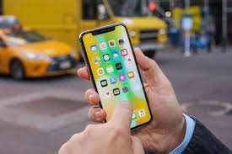
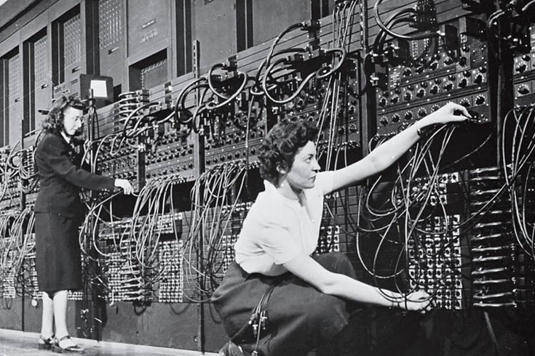

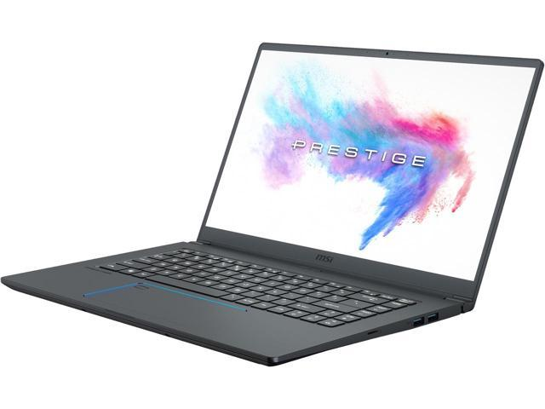
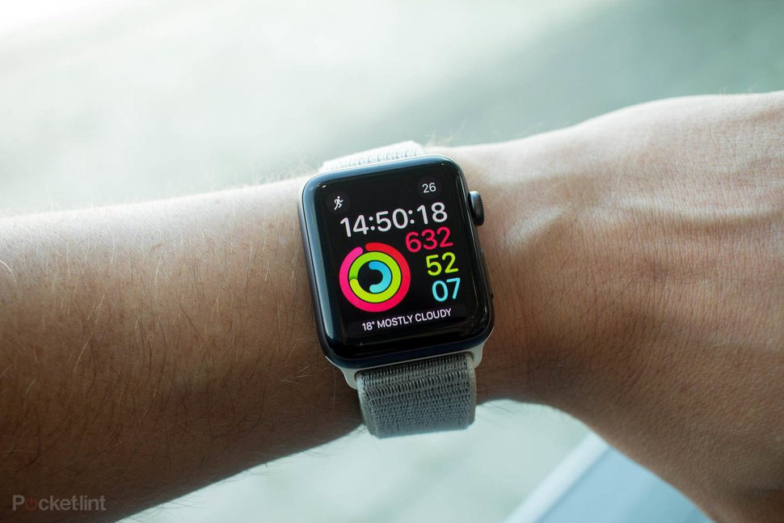
History of Computers
Image Credit: Casey Cass, CU Boulder
1950s
1990s
Now
Time
# of computer/person
Notes:
In history, the number of computer dominated by one person has been significantly increased.

Slide 5

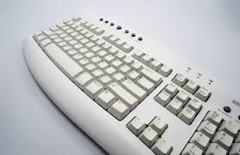
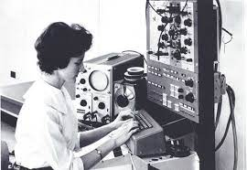
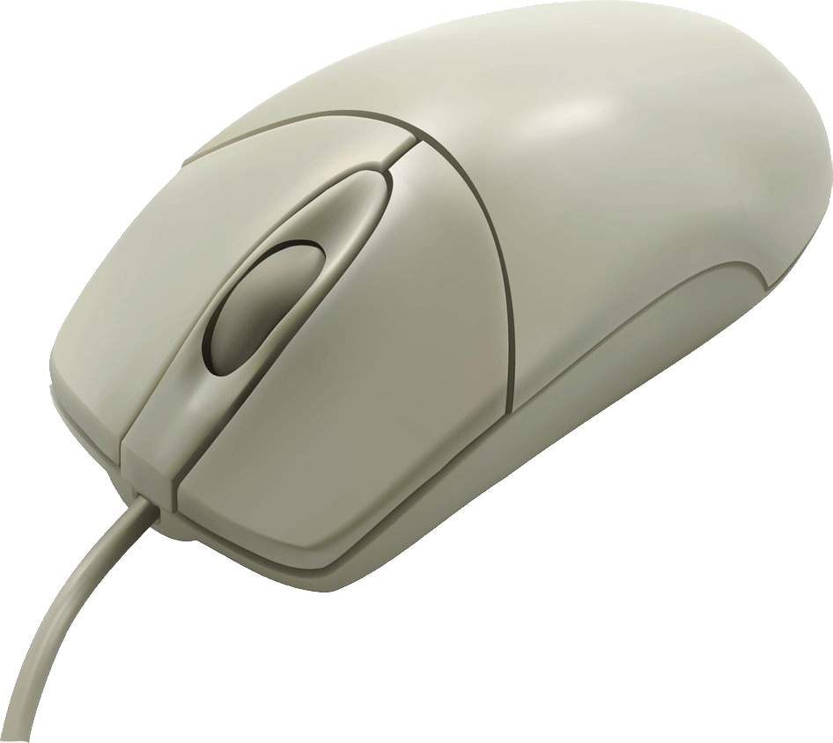
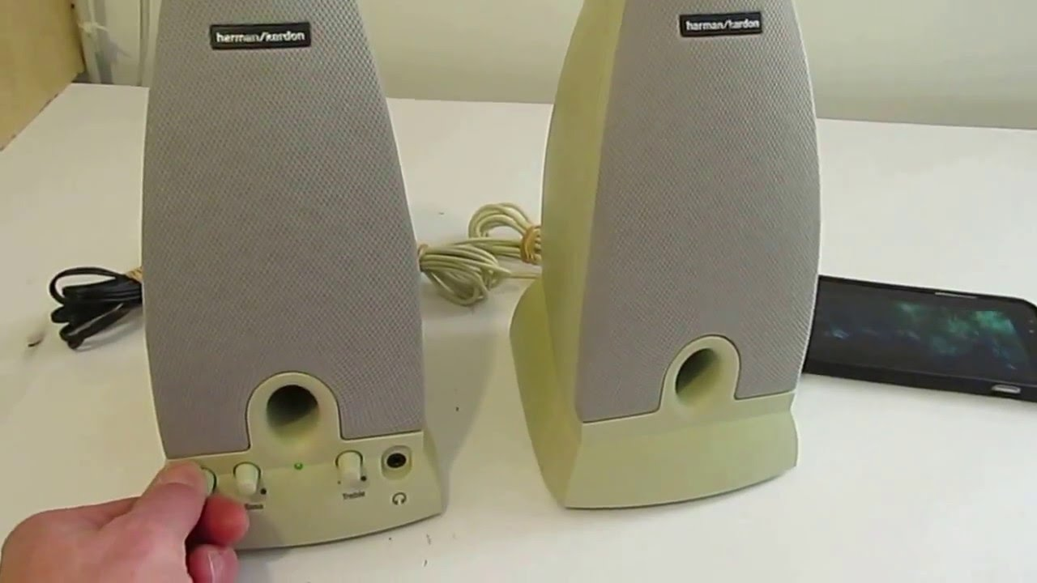
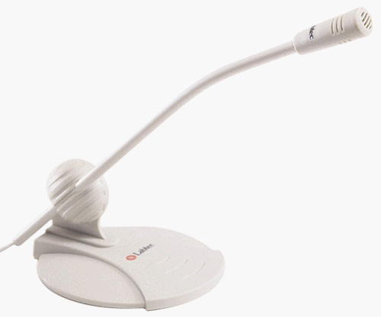
History of Human-Computer Interaction
Image Credit: Casey Cass, CU Boulder
1950s
1990s
Now
…
Notes:
In terms of interaction devices,

Slide 6
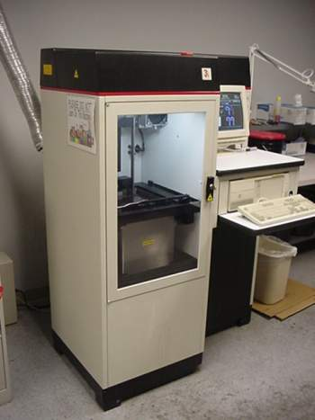
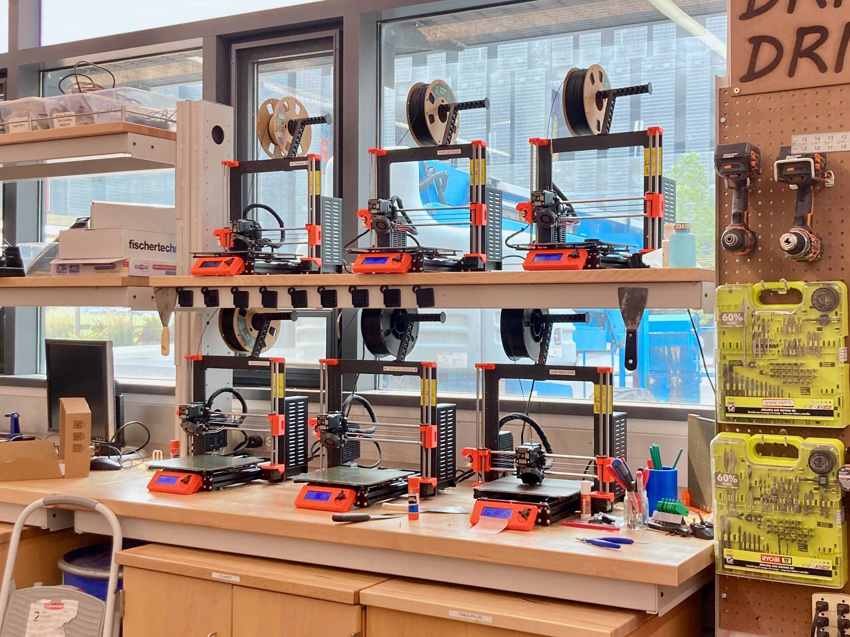
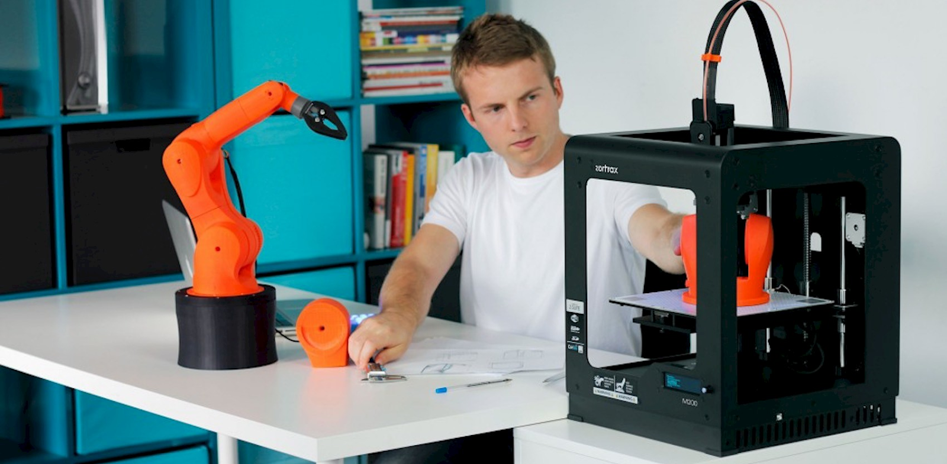
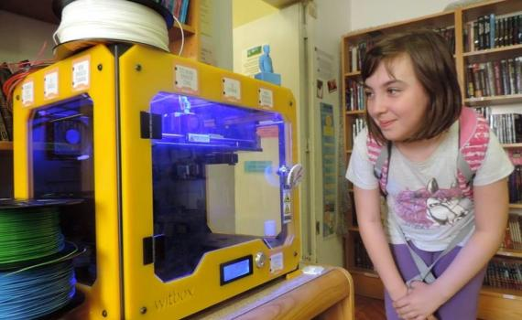
History of Digital Fabrication Machines
Image Credit: Casey Cass, CU Boulder
1990s
2010s
Now
Time
# of 3D printers/person
Notes:
In history, the number of computer dominated by one person has been significantly increased.

Slide 7
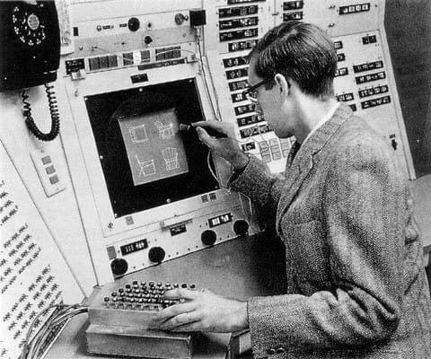
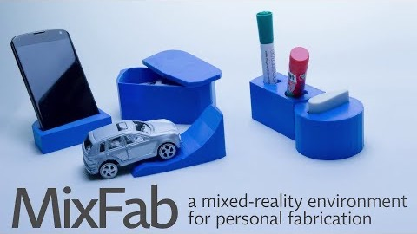
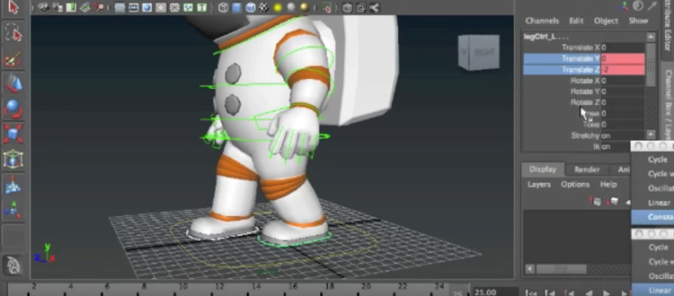
History of Human-Digital Fabrication Interaction
Image Credit: Casey Cass, CU Boulder
1960s
2010s
Now
Notes:
There has been not so much of change in design; using keyboard to script, or using mouse to click toolbox and drag drop

Slide 8
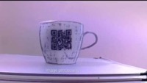
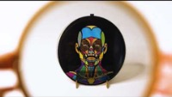
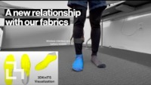
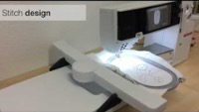
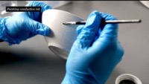
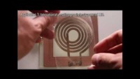
Now you can build ANYTHING
3D printing
Laser cutting
Looming
Digital embroidery
Vinyl cutting
Inkjet printing

Slide 9
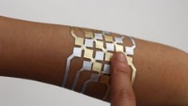
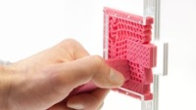
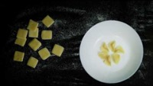
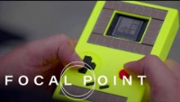
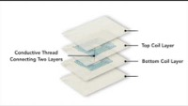
…integrating computing into everyday objects
Body
Physical interfaces (e.g., door)
Food
Batteryless Game devices
Furniture

Slide 10
Learning Objective
Learn fabrication techniques and special materials
Learn fabrication process: how do future interfaces work?
Build your own fabrication methods, OR
Build your own physical objects that sense, actuate, and communicate with humans
Develop non-invasive interactions that are useful for context-aware everyday devices

Slide 11
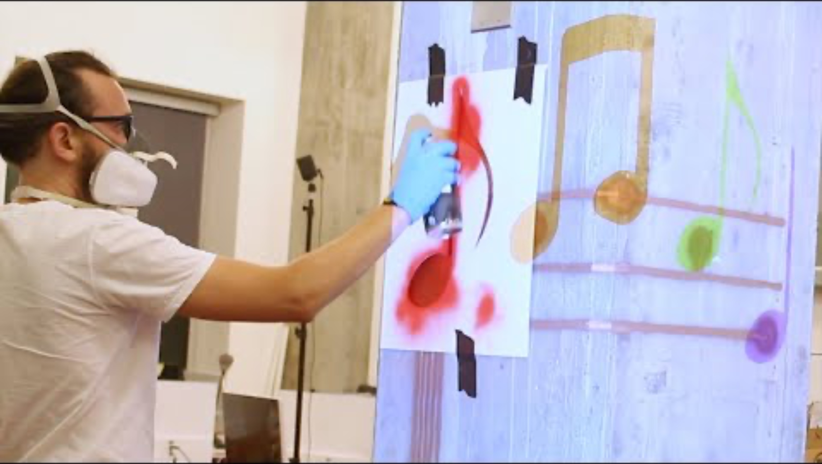
Wait, non-invasive interactions?
Conventional
Non-invasive
Vs.

Slide 12








Non-invasive interaction builds upon context-awareness
Command-based
Context-based
Vs.

Slide 13
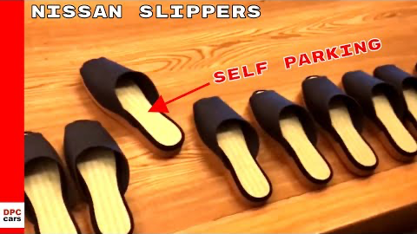
Nissan self-organizing computers

Slide 14
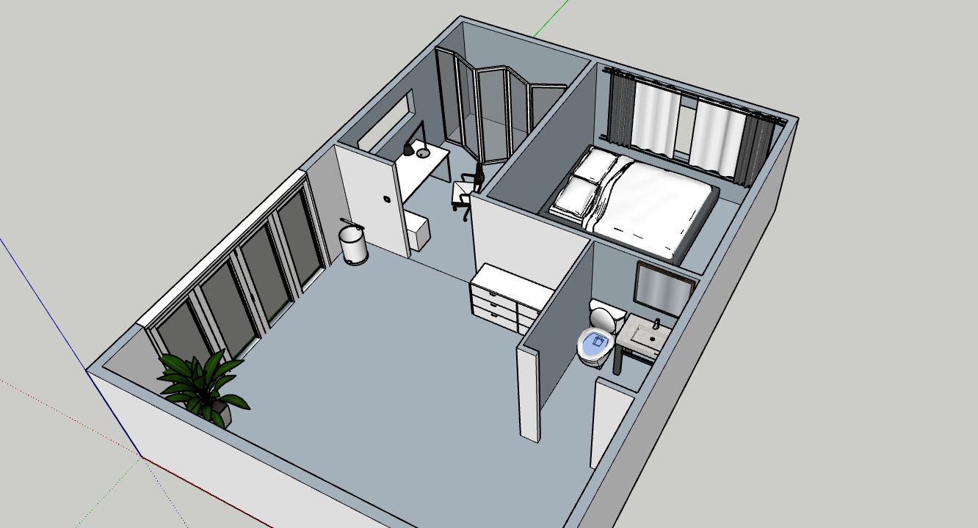
Folding Closet
Curtains
Desk Lamp
Pillows and beds
Trash bin
Faucet
Windows
Chair
Toilet (lids, knobs)
Planters
Drawer
3min. Discussion: What can everyday objects sense?
Notes:
Okay, let’s zoom out, to be little more practical, feasible, less funny

Slide 15
Learning Objective (Cont’d)
Learn fabrication mechanisms and materials
Learn fabrication process: how do they interpret human designs?
Build your own fabrication methods
Build your own physical objects that sense, actuate, or communicate with humans
Fabricate non-invasive interactions that are useful for context-aware everyday devices
Design design tools to improve accessibility

Slide 16
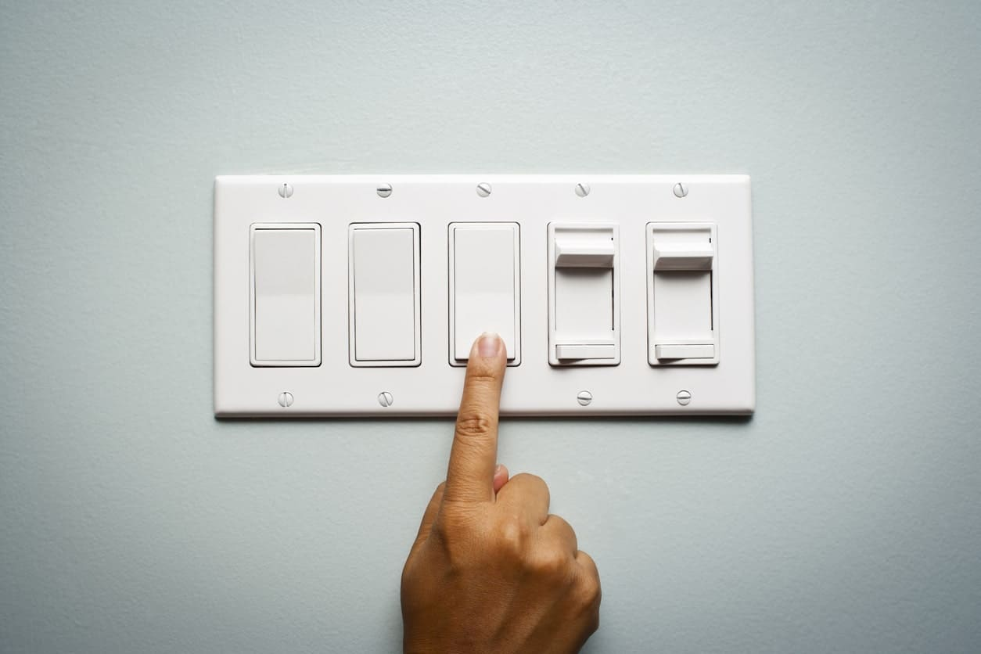
Why should we care about Context Awareness?

Slide 17
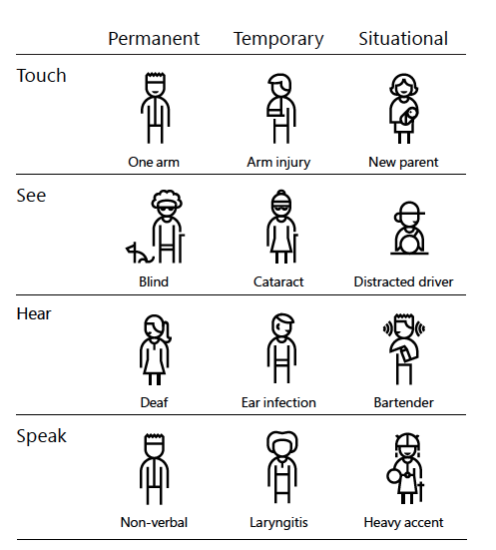
Accessibility is context-dependent

Slide 18
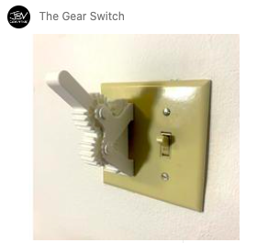
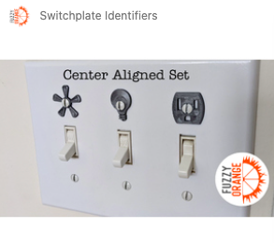
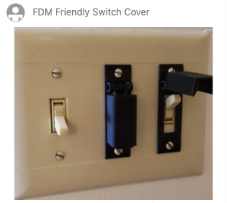
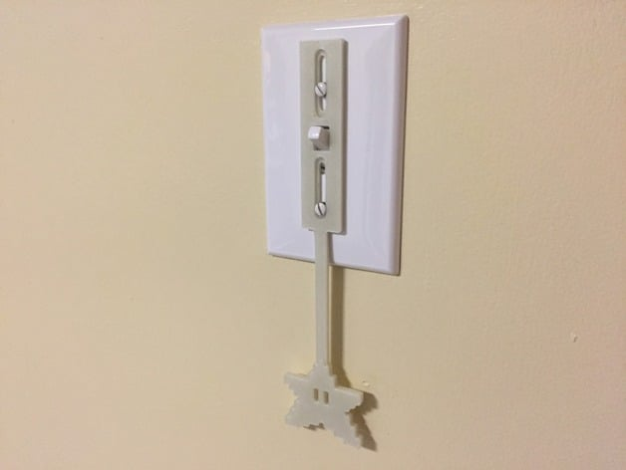
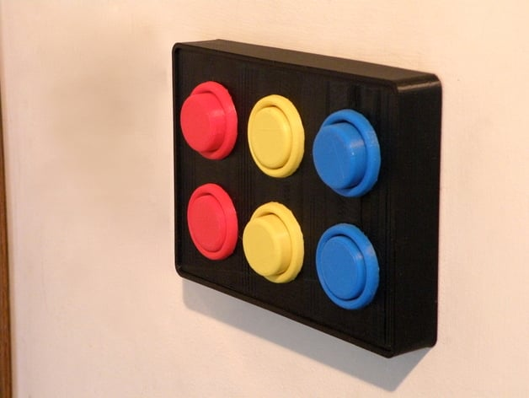
Different people need different solutions

Slide 19
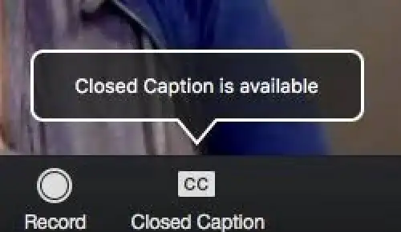
Many technologies are firstly developed for accessibility

Slide 20
Our Class goals
Learn digital fabrication skills and special techniques
Be able to replicate latest fabrication techniques
Augment passive physical interfaces into novel interfaces
Enable new design/fabrication workflows
Redesign interaction
Repurpose or transform existing objects using fabrication

Slide 21
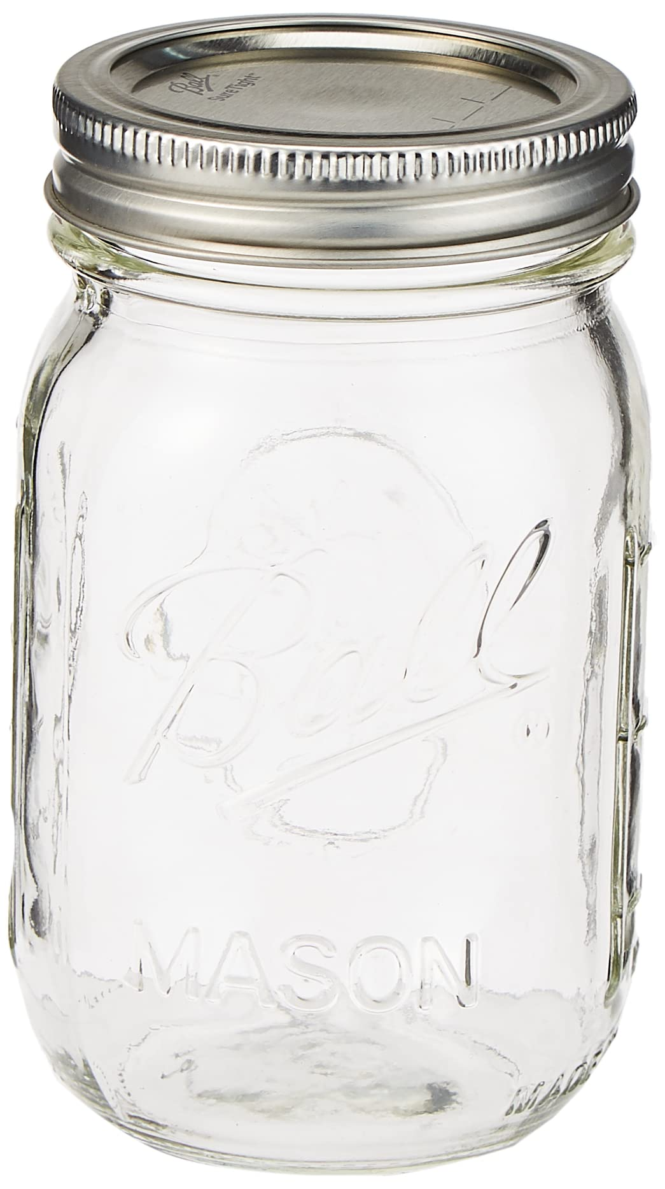
What do we mean by repurpose through augmentation?

Slide 22
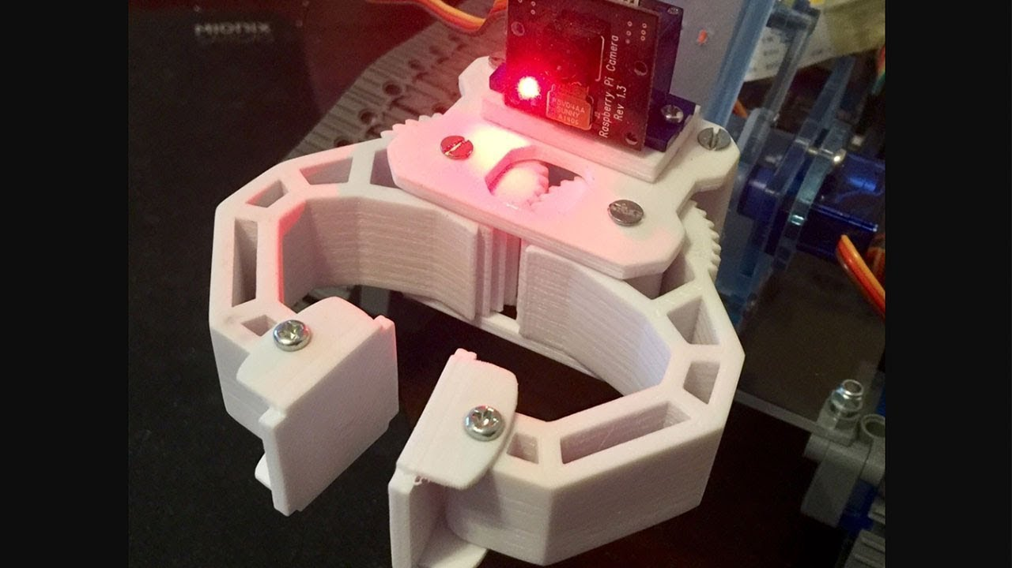
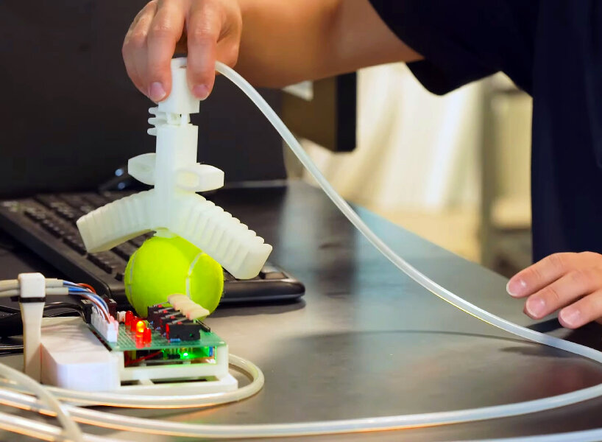
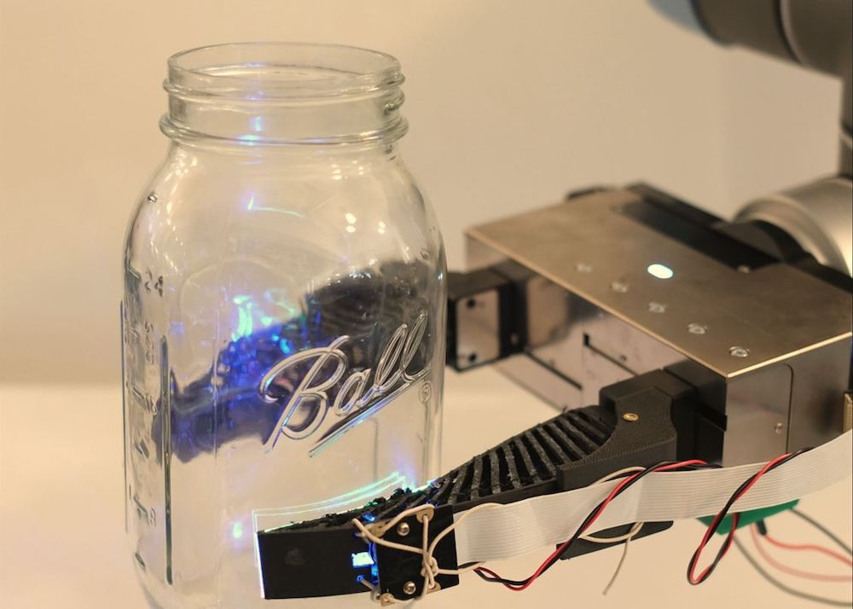
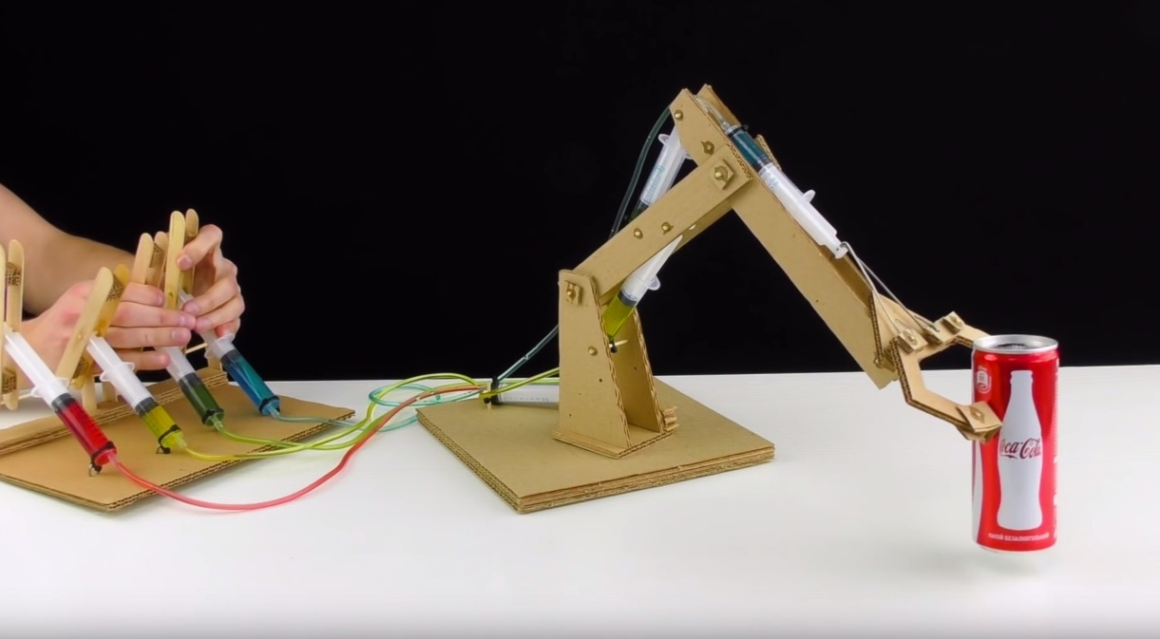
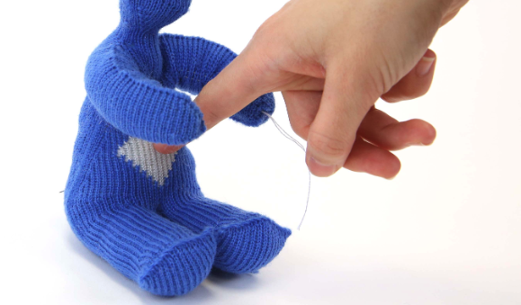
Digitally Fabricated!

Slide 23
Why Fabrication?

Slide 24
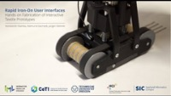
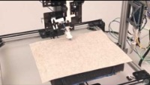
It democratizes the way we build things

Slide 25
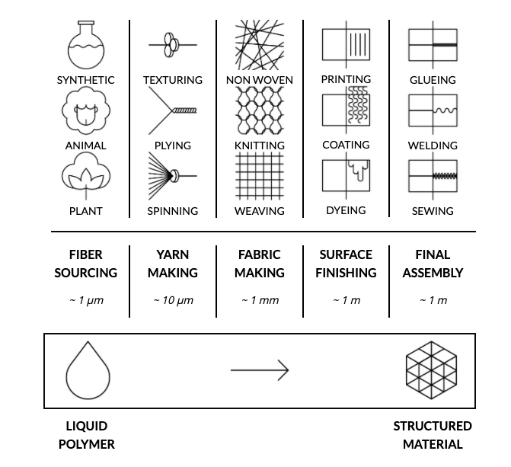
So it simplifies a supply chain
Current Supply Chain
Future Supply Chain
Credit: OPT Industries

Slide 26
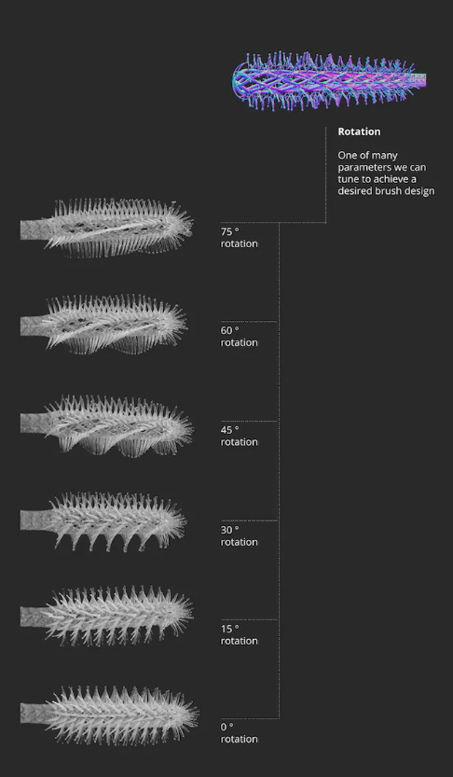
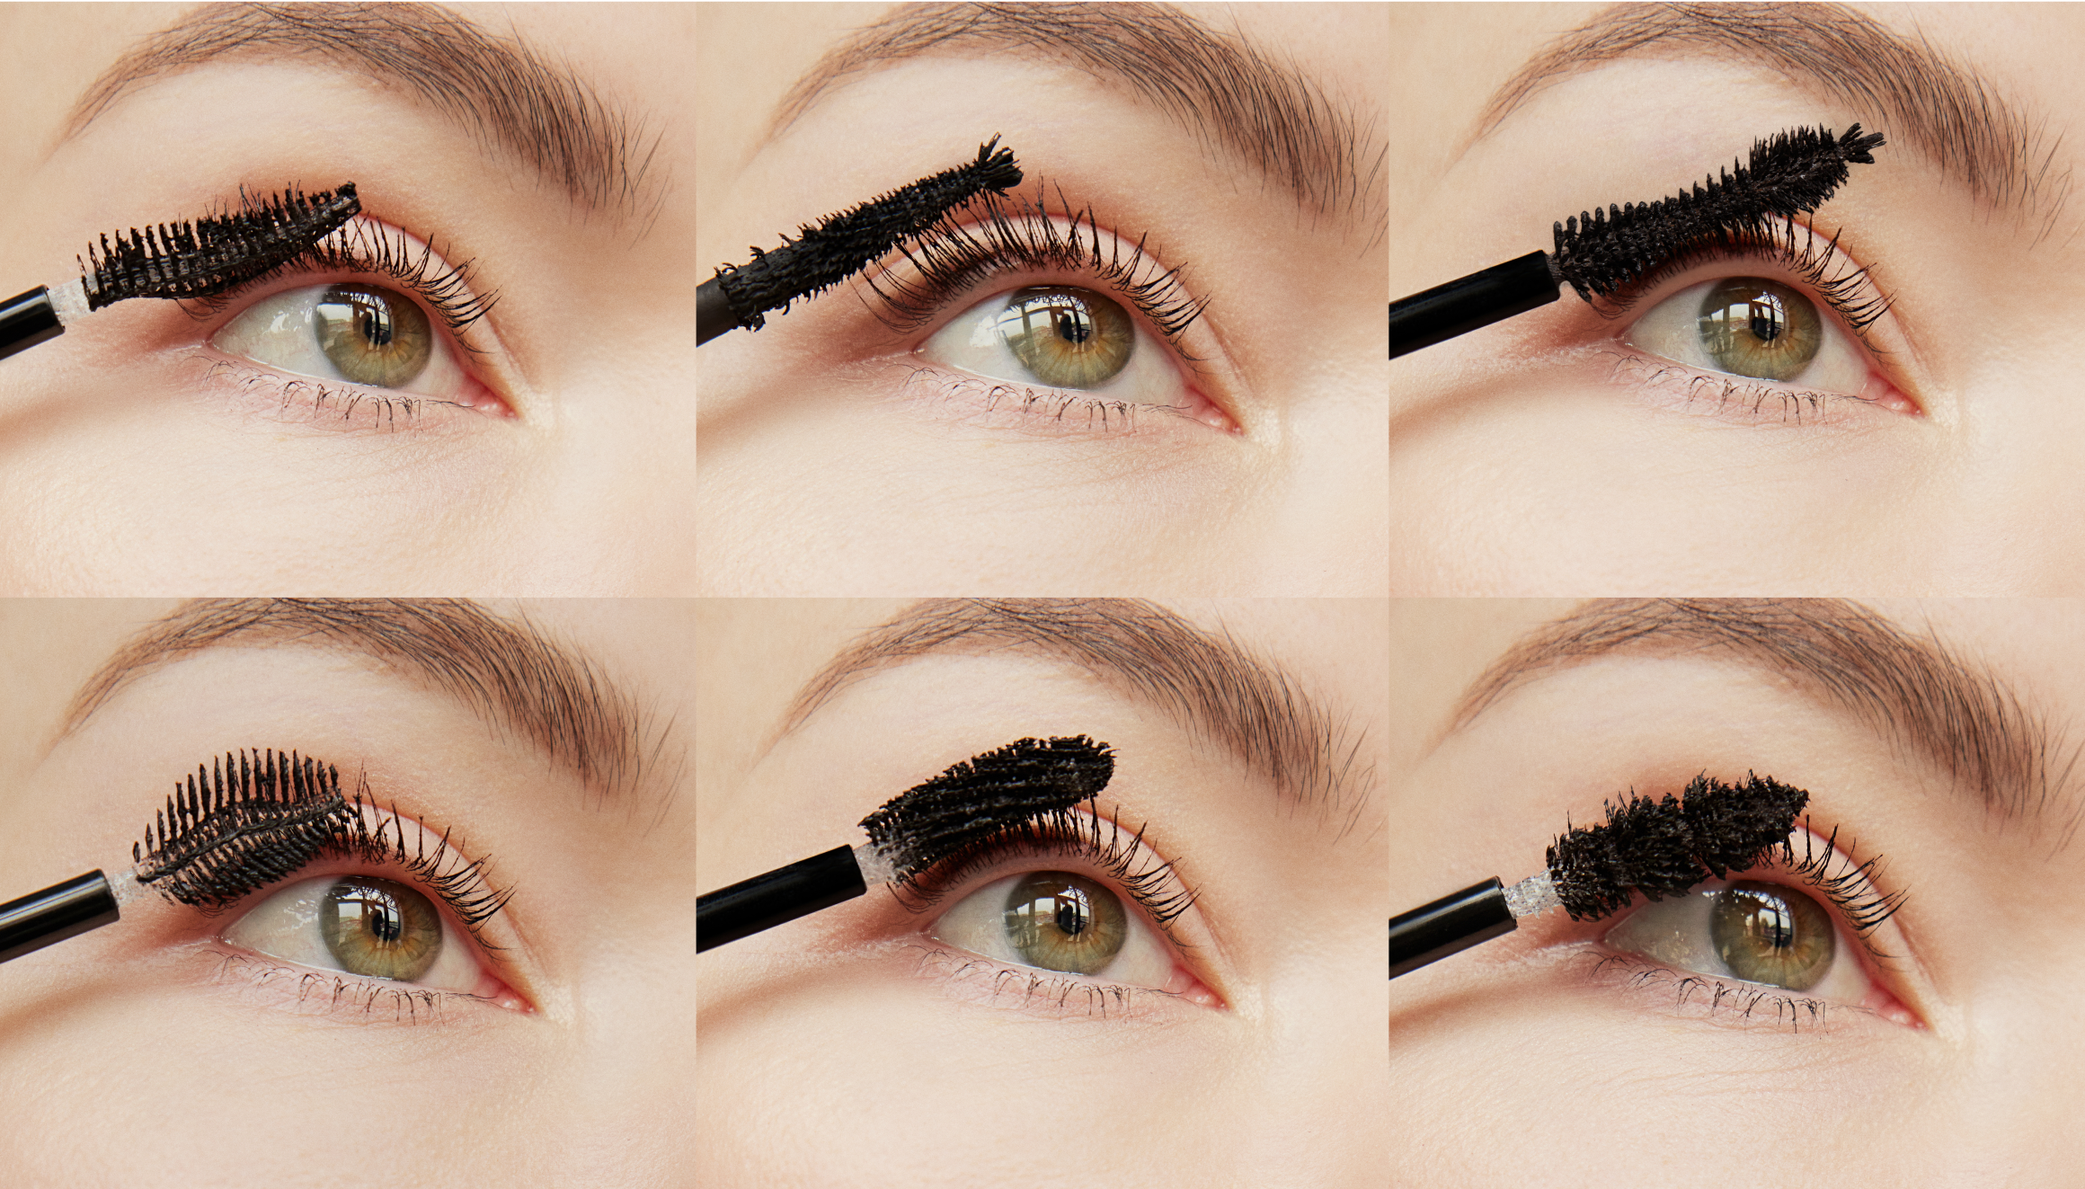
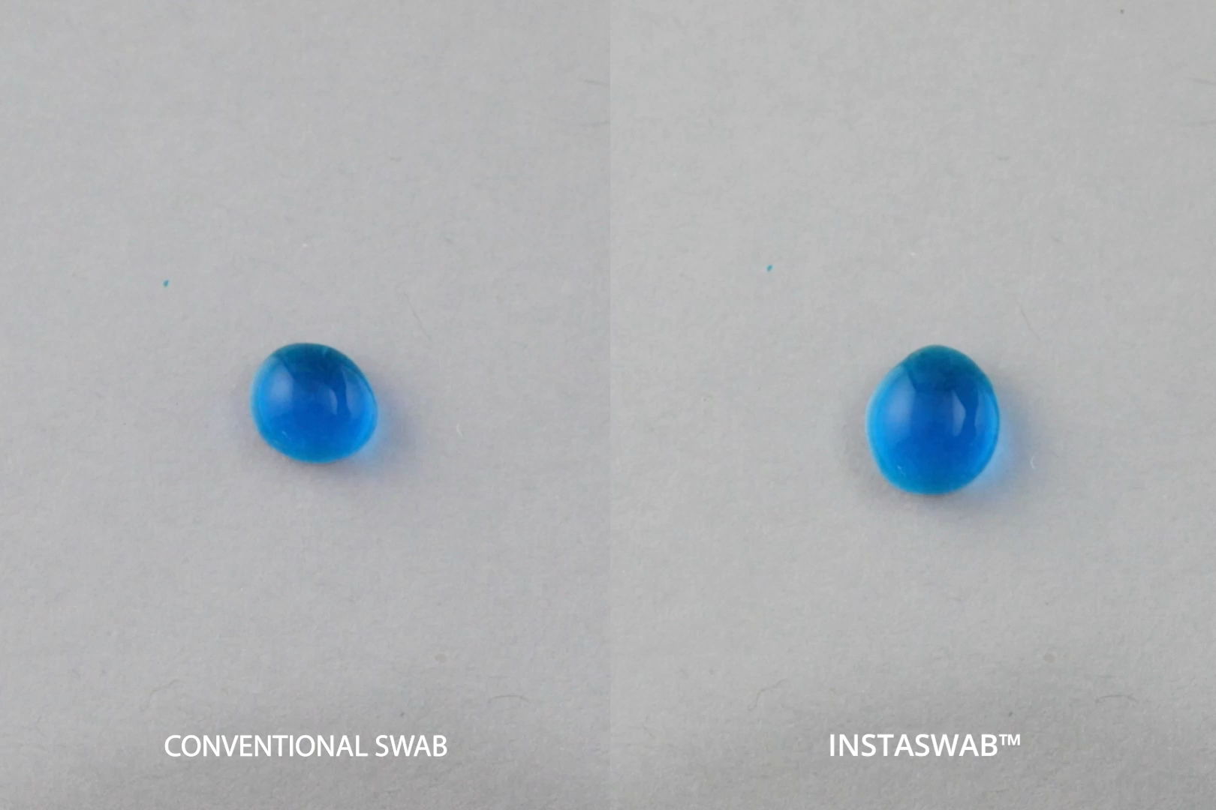
Yes, these are 3D printed!
Credit: OPT Industries

Slide 27

So the technology advances impact the world

Slide 28




Slide 29

Bad designs are everywhere

Slide 30


Slide 31


Wait, everything fails..
Notes:
And we will eventually succeed!

Slide 32



Wait, everything fails, AND that’s the start!
Notes:
And we will eventually succeed!

Slide 33
Course Overview

Slide 34



What do we learn?
Laser cutting and engraving– by parameters!
Basics, Applications
Design to laser cut

Slide 35

What do we learn?
Basic/advanced 3D printing (Machines, Materials, Slicers)
Applications
Design to model 3D objects

Slide 36
What do we learn?
Input
Programmatic Control
Output
Notes:
How to operate machines (mechanisms) using commands
Firmware to connect user inputs
Natural user interactions for new printing

Slide 37
Class Structure
Today
Sep.
Oct.
Nov.
11:30am – 12:30pm Lecture & Discuss paper
12:30pm – 1:30pm Studio & Lab
1:30pm – 2:30pm Individual meeting with the
instructor for progress updates
Work on your Project
Instructor & Mentors will be available
Final project
presentation

Slide 38


Class Structure
1 hour:
Discuss the read paper
Meet in EABA121 (here!)
The rest:
Try, design, and build
Meet in EABC 107C
Notes:
You might think your teammate can represent your work, you have videos so you don’t need to present..
No, you Do need to physically come and review your cohorts’ works.
If you don’t come, your grade will be 0 for each portion, I won’t provide you any materials to provide peer reviews. Which means you are also already missing one of assignment grades.

Slide 39

A Little bit about myself
Jeeeun Kim, PhD
Assistant Professor in Computer Science & Engineering
5th year at A&M and Texas
Lead HCIed Lab
Studied at University of Colorado (Boulder)

Slide 40


A Little bit about myself

Slide 41
Assignment in 2 weeks (Next week is Labor day!)
Fill in the Intro Survey
Use free slide template, watch the videos in this slide
2 pages: Introduction
major, background, the biggest project o you’ve done so far
the motivation for taking this class
what you want to achieve in this class
5 pages: 1 page each for 5 final project ideas
What problem does this solve?
Why is it important?
How did previous works/projects approach the same problem?
What are the major challenges expected?
How will world be different with this?

Slide 42

More Inspirations: 3D printed textile

Slide 43

More Inspirations: 4D printing

Slide 44

Many more available at Instructables https://www.instructables.com/

Slide 45
Course Website (Under Construction..)
https://HCIed.info → Classes
Class announcements including assignment templates
Lecture slides
Class reading

Slide 46
Not everything will be perfect!

Slide 47
Next week: Project Idea Presentation + Studio
Paper pinhole camera
Many great techniques to manipulate papers for physical fabrication
Bring craft tools and materials
Must: scissors, paper knife, glues
Recommended: thick paper, ruler, color pens

